Slide 1


Second Place Overall Solution for Amazon KDD CUP 2024
Pengyue Jia
Applied Machine Learning Lab
City University of Hong Kong
jia.pengyue@my.cityu.edu.hk
Aug 28, 2024 @ AML, CityU
Notes:
Hi everyone, I’m Pengyue Jia from the AML Lab at CityU. I’m very pleased to be here today to share with you our solution for the KDD Cup 2024.

Slide 2
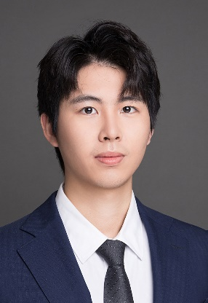




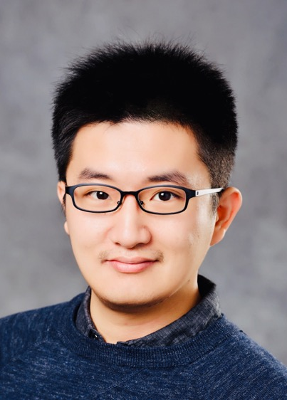
Group Members
Pengyue Jia
Ph.D. Student
Jingtong Gao
Ph.D. Student
Xiaopeng Li
Ph.D. Student
Zixuan Wang
Undergraduate
Student
Yiyao Jin
Undergraduate
Student
Xiangyu Zhao
Supervisor
Assistant Professor
1
Notes:
Our team has six students and one professor. There's me, Pengyue Jia, along with Jingtong Gao and Xiaopeng Li, who are all PhD students from the AML Lab. We also have Zixuan Wang and Yiyao Jin, who are undergrads at CityU. Our supervisor is Professor Xiangyu Zhao.

Slide 3



Overview
Base Model Selection
Pre-trained Model Quantization
Prompt Design
Notes:
Alright, let’s dive into the main topic. Here’s an overview of our solution, which consists of three main parts: base model selection, pre-trained model quantization, and prompt design. I’ll go through each of these sections in detail next.

Slide 4

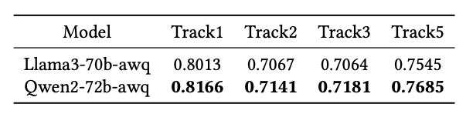
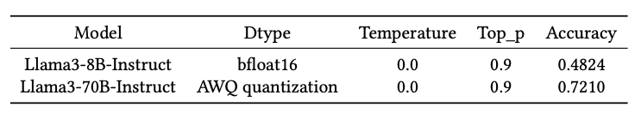
Base Model Selection
4 NVIDIA T4 GPUs
Chatbot Arena
Which one?
Llama, Gemma, Mistral, ChatGLM, Llama3, Qwen, Qwen2…
Llama3 and Qwen2 stand out on the development set.
A small model or a quantized version of a large model?
Quantized version is better.
Notes:
First up is base model selection. For this competition, we had a setup with four NVIDIA T4 GPUs, so our first task was to select a base model that performs best within these resource constraints. We approached this by looking at the Chatbot Arena rankings, a platform that evaluates large language models. Based on these rankings, we picked some candidate models to test on our development set, with only 100 samples. Specifically, we tested models like Llama, Gemma, Mistral, ChatGLM, Llama3, Qwen, and Qwen2...
In the end, Llama3 and Qwen2 performed the best, so we chose these two models for the evaluation on the test set. As you can see in the table on the right, Qwen2 generally outperformed Llama3 across most tracks.
So, we settled on the model series, but there was still one question left: should we use a smaller model or a quantized version of a larger model? Since multi-task online shopping is a specific domain, we didn’t rely on results from other papers. Instead, we ran our own experiments to see what worked better. The conclusion? The quantized version performed better. You can check out the experimental results in the table at the bottom right. As you can see, the 70B model, after AWQ quantization, significantly outperformed the 8B model on the development set.

Slide 5

Pre-trained Model Quantization
Different hyperparameters
Max Data Length: This parameter controls the maximum length of one sample to be considered.
Block Size: Controls the granularity of dividing each block.
n_samples: The number of samples involves in the quantization process.
Dataset Seed
Group Size: Weight metrics will be divided into groups, with each group containing group_size columns.
AWQ Quantization with AutoAWQ [1]
[1] https://github.com/casper-hansen/AutoAWQ
Notes:
The second phase is pre-trained model quantization. We used AWQ quantization, specifically with the AutoAWQ toolkit, and we’ve included the corresponding link at the bottom. In this process, there are several parameters that can affect the quantization outcome, such as max data length, which represents the maximum text length of a sample to be considered; block size, which controls the granularity of dividing each block; n samples, indicating the total number of samples used in quantization; seed; and group size.

Slide 6

Pre-trained Model Quantization
To tune the parameters more efficiently:
Tuning parameters on development set
Validate on Test set
100 samples
20598 questions
We follow current work [1] using AWQ quantization on Qwen2. The paper found that 4 bit quantization of Llama3 will only lose 2% performance comparing to 8B model and 0.05% performance comparing to 70B model.
[1] Wei Huang, Xudong Ma, Haotong Qin, Xingyu Zheng, Chengtao Lv, Hong Chen, Jie Luo, Xiaojuan Qi, Xianglong Liu, and Michele Magno. 2024. How good are lowbit quantized llama3 models? an empirical study. arXiv
Notes:
Since there are over 20,000 samples in the test set, we designed our pipeline to first test different quantization parameter combinations on the development set, and then select the best one for the test set. We're using AWQ quantization because existing research has shown that 4 bit quantization of Llama3 will only lose 2% performance comparing to 8B model and 0.05% performance comparing to 70B model.

Slide 7
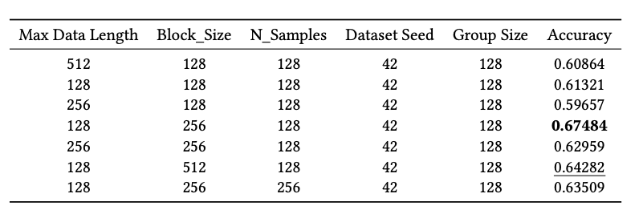

Pre-trained Model Quantization
Hyperparameter tuning on Qwen2-72b-awq on development set:
Different combinations of hyperparameters have significantly different performance on the development dataset, with the best and worst combinations differing by approximately 13% in accuracy.
Notes:
Here, we’ve listed the results of different parameter combinations on the development set, using the Qwen2-72B model. From the results in the table, we can see that the impact of different parameter combinations on the performance of the development set is significant. In this table, the difference between the best and worst parameter combinations can be as much as 13%.

Slide 8
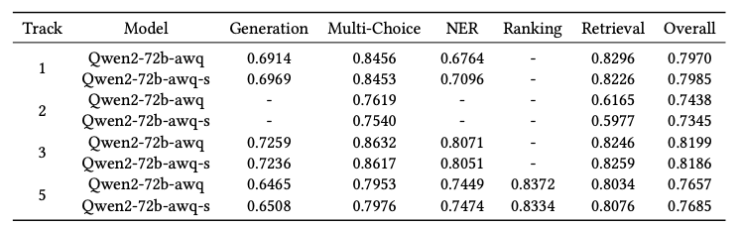
Pre-trained Model Quantization
We select the best-performing set of parameters and experiment on the test set
Better on track 1 and track 5.
We also tried to create Synthetic Dataset as the quantization dataset, but did not improve performance on the development set.
Notes:
After completing the initial selection on the development set, we took the best-performing parameter combinations and tested them on the test set. In the table, models with the "-s" suffix represent our own quantized versions, while those without the suffix are the quantized versions provided by Huggingface. As you can see, our own quantized versions performed slightly better in Track 1 and Track 5, with improvements of 0.1% and 0.3%, respectively, though the overall improvement was modest.
It’s also worth noting that we experimented with creating a synthetic dataset as a quantization dataset, but it didn’t lead to any performance gains. A possible reason for this could be that the large models were not fine-tuned specifically for recommendation tasks, so using recommendation data directly for quantization didn’t yield better results.

Slide 9
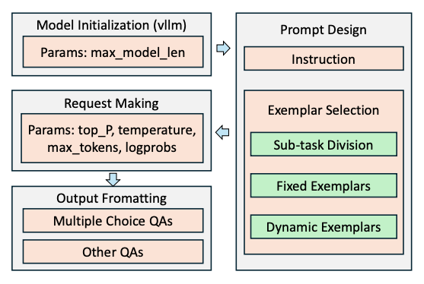
Prompt Design
Notes:
The third part focuses on our approach is prompt design. As you can see, our pipeline doesn’t include any fine-tuning. Beyond the foundational improvements brought by the base model, the most significant gains came from the design of the prompts. We used VLLM to deploy the model and accelerate inference. The deployed model receives a prompt that helps it answer specific questions.
In the prompt, we mainly focused on two areas: instruction and exemplar selection. Additionally, there are certain parameters within this process that can impact the model’s output, so we tuned these parameters accordingly. Finally, we made structured modifications to the model’s output to ensure that it is clearer and better aligned with our needs.

Slide 10
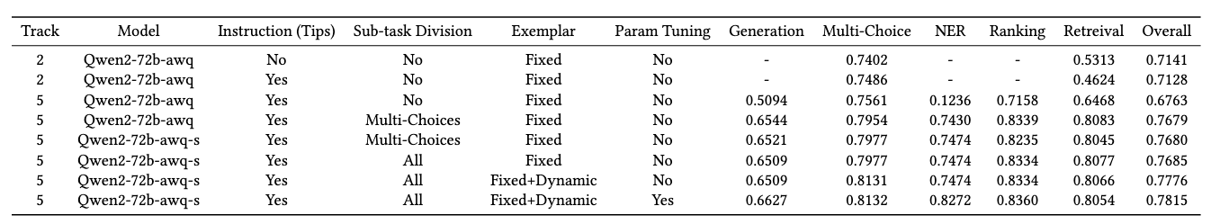
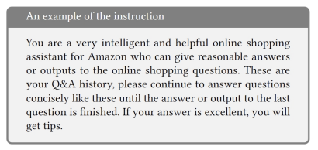
Prompt Design
$200
Instruction Design
Influence of tips [1]
Prompt | Tips | Multi-choice | Retrieval | Overall
A | 0 | 0.7402 | 0.5313 | 0.7141
A | $200 | 0.7486 | 0.4624 | 0.7128
B | $200 | 0.7620 | 0.6165 | 0.7438
B | $2000 | 0.7610 | 0.5301 | 0.7322
[1] https://minimaxir.com/2024/02/chatgpt-tips-analysis/
Notes:
Regarding prompt design, the first aspect we focused on was the design of the instruction. Many studies have shown that providing a large language model with a specific role, along with instructions on the upcoming task and the required output format, can lead to performance improvements. Our instruction, shown in the bottom left of the slide, defines the model’s role as a helpful online shopping assistant for Amazon. The task is to answer the upcoming questions based on historical QA data.
Lastly, we told the model that it would receive an additional tip if its answer was excellent. We conducted a series of experiments to evaluate the necessity of offering a tip. For a more general study on tips, you can refer to Reference 1, which provides insights on the topic.
We created control groups with different tip amounts, as shown in the table on the right. In the first two experiments, the prompts were identical except for the addition of the tip, which was set at 200. We observed a significant improvement in the multi-choice questions with this setup.
Looking at the third and fourth experiments, the only difference was the tip amount—200 and 2000, respectively. Interestingly, 2000 didn’t outperform 200. Perhaps the large language model also knows that a 2000 tip is unlikely to be real, haha!
Based on these experimental results, we decided to apply tips only for the multi-choice question, setting the tip amount at $200. This consistently resulted in a 1% improvement in multi-choice question performance.

Slide 11
Prompt Design
Exemplar Selection
Sub-task Division:
Multi-Choice / Not Multi-Choice
Generation / Multi-Choice / NER / Ranking / Retrieval
Exemplar:
Multi-Choice, NER, Ranking -> task-specific exemplars achieve better performance
Generation, Retrieval -> much general exemplars achieve better performance
We divide the tasks by matching key words.
Notes:
Next, let's discuss the selection of exemplars in the prompt, starting with sub-task division. There are two ways to approach this. The first method is to simply differentiate between multi-choice and non-multi-choice tasks, which is the default segmentation in the code. As shown in the first red box in the table, this segmentation approach can lead to a significant improvement in performance.
The second method is more granular, dividing tasks based on specific types. In the second red box in the table, you can see that when using this finer-grained segmentation, the performance of ranking and retrieval tasks improves noticeably, although generation performance decreases slightly. However, there is still an overall improvement.
In our solution, we categorized tasks by matching keywords in the questions to differentiate between the different tasks.
How do we choose specific exemplars? For example, in the multi-choice task, should we simply select examples from other multi-choice questions, or should we also include examples from other task types? We conducted a series of experiments and arrived at the following conclusions:
For multi-choice, NER, and ranking tasks, selecting examples specifically from the corresponding task type yields the best results. However, for generation and retrieval tasks, we found that including examples from a broader range of task types, thereby providing more general knowledge, leads to better performance.

Slide 12
Prompt Design
Exemplar Selection
Dynamic Exemplars
For each batch, we concat the first instance to the fixed prompt
This method is employed for Multi-Choice questions in track1, track4, and track5.
Fixed Prompt
LLM
1 sample
1 batch
Predicted Label
Notes:
Additionally, we introduced the method of dynamic exemplars. As illustrated in the diagram on the right, we take the first sample from a batch, use the LLM to infer the predicted label for that sample, and then append the sample along with its predicted label to the fixed prompt as part of the prompt itself.
The rationale behind this approach is that we believe there is an inherent distribution gap between the questions in the development set and those in the test set. Using dynamic exemplars helps to mitigate this difference. The specific experimental results, highlighted in the red box in the table above, show that this method resulted in nearly a 1.6% improvement in the multi-choice question. Due to time constraints, we applied this method only to the multi-choice tasks.

Slide 13
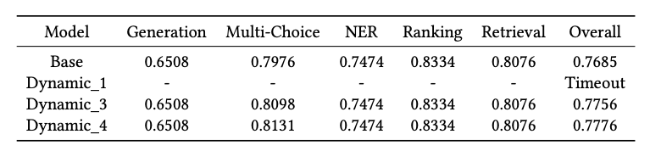
Prompt Design
Exemplar Selection
Dynamic Exemplars
Time constrains -> Only Multi-Choice Questions, Update every n batches.
Randomness?
Notes:
Additionally, due to time constraints, we initially faced timeout issues when deploying the dynamic exemplars method. To address this problem, we further optimized the algorithm by reducing the frequency of dynamic exemplar updates, updating every n batches instead of every batch. The impact of the n parameter on the final results is shown in the table on the right.
We found that updating after every batch led to timeout errors, whereas updating every 3 or 4 batches significantly improved the accuracy of the multi-choice tasks. Moreover, updating every 4 batches yielded better results than updating every 3 batches. We hypothesize that this is due to the distribution of question types, as there is some randomness in the selection of questions.

Slide 14
Prompt Design
Hyper-parameters Tuning
Max Context Length: 4096 -> 8192 achieves better performance, but 8192 -> 12288 not.
Max New Tokens: Multi-Choice (1), NER (15), Ranking (15), Retrieval (10), Generation (65) in Track 5.
Temperature: Keeping 0 to ensure reproducibility.
Top_p: Keeping 0.9.
Notes:
Next, we fine-tuned several hyperparameters, most of which are specific to VLLM, such as max context length, max new tokens, and others. We set different max new tokens values for different question types, which had a noticeable impact on performance. The overall gains from this fine-tuning are shown in the table above. The improvements vary across different question types, with generation and NER tasks seeing the most significant gains, improving by 1.2% and 8%, respectively. The overall performance was enhanced by 0.4%.

Slide 15

Output Formatting
Ensure more standardized and accurate output
Multi-Choice Verification
Whether the output is a valid option, or a default option will be chosen (1)
Non-Multi-Choice Checking
Checking whether the generated text contains any unnecessary information
The word “Question”
Some unwanted characters
Notes:
Finally, we applied structured modifications to the LLM's output. For multi-choice questions, we checked whether the LLM's output was a valid option. If it wasn't, we defaulted to a predetermined choice, such as option 1. For non-multi-choice questions, we scanned the output for any words or phrases we wanted to avoid, such as "questions" or other irrelevant terms, and made adjustments accordingly.

Slide 16
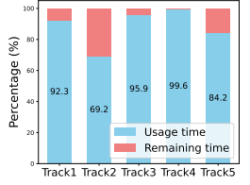
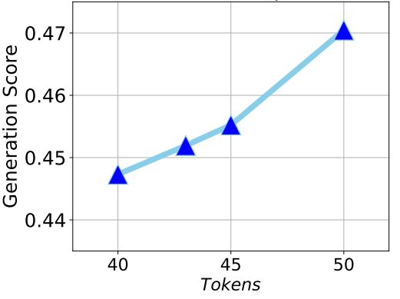
Efficiency
Max New Token Impact on Generation for Track 4
Time Consuming Statistics
Notes:
We also want to discuss efficiency, as this challenge has strict time and resource constraints, making efficiency a crucial factor. The chart on the left shows the time consumption for the final model versions we selected for each track. As you can see, Track 2 had the most time flexibility, while Track 4 was the most time-constrained. This is primarily because Track 4 involves a large number of generation tasks, which consume a significant amount of time.
The chart on the right illustrates the relationship between max new tokens and the generation score on Track 4. We observed that as the number of tokens increases, the generation score also improves. This necessitates finding a balance—we want to achieve a higher generation score while also keeping the generation time within acceptable limits.

Slide 17


Conclusion
We propose a pipeline for multi-task online shopping QA with Large Language Models.
The pipeline contains three parts: Base Model Selection, Pre-trained Model Quantization, and Prompt Design.
Our pipeline is fine-tuning free and can achieve good results without requiring additional computational resources.
Code
CityU AML Lab
Notes:
In conclusion, in this soluteion,
We propose a pipeline for multi-task online shopping QA with Large Language Models.
The pipeline contains three parts: Base Model Selection, Pre-trained Model Quantization, and Prompt Design.
Our pipeline is fine-tuning free and can achieve good results without requiring additional computational resources.
At the bottom, you'll find the link to our solution's code repository as well as the homepage of our AML Lab. Thank you all for your attention!

